Slide 1

Unraveling Twitter Hate Speech: A Comparative Analysis Using LDA and QDA Techniques, Paper Id:157
ICDSMLA-23
Nagireddy Moneesh
Department of Computer Science and Engineering
Amrita Vishwa Vidyapeetham, Kollam,Kerala ,India
5th International Conference on Data Science, Machine Learning & Applications

Slide 2
Objective Introduction Literature Review Dataset Methodology Results and Discussions Conclusion References
Presentation Contents

Slide 3
Investigate Twitter Chats: Aim: Identify and differentiate between tweets of hate and non hate chats. Analyze Tweets for Hate Speech: Tools: Utilize Quadratic Discriminant Analysis (QDA) and Linear Discriminant Analysis (LDA) methods to detect hate speech in tweets. Facilitate Policy Reforms and Awareness: Impact: Leverage findings to aid in early detection of hate speech, contributing to policy reforms and increasing awareness about responsible social media use.
OBJECTIVE

Slide 4
Proliferation of Social Media: Highlight the surge of social media usage, with 3.96 billion users in 2022, and its significant impact on public opinion and global discourse. Rise of Hate Speech on Twitter: Address the increase in hate speech on platforms like Twitter, defining it as speech that promotes hate or violence based on race, religion, ethnicity, sexual orientation, disability, or gender. Consequences of Hate Speech: Emphasize the negative impacts of hate speech, including mental health issues and threats to democratic societies. Challenges in Manual Detection: Discuss the limitations of manual hate speech detection, such as time-consumption, inaccuracy, and lack of scalability.
INTRODUCTION

Slide 5
Hate Speech Detection on Twitter Using BERT Algorithm by A. Nayla, C. Setianingsih and B. Dirgantoro. Hate Speech Detection on Twitter Using Long Short-Term Memory (LSTM) Method by S.S.Syam, B. Irawan and C. Setianingsih. Hate Speech Detection using ML algorithms by A. Razdan and S. S. Domain Based LDA and QDA by P. Juszczak, D. M. J. Tax, S. Verzakov and R. P. W. Duin. An Analysis of COVID-19 related Twitter Data for Asian Hate Speech Using Machine Learning Algorithms by S. Shah, X. Yuan and Z. Tyler.
LITERATURE REVIEW

Slide 6
Overview of the Dataset: Compiled by Rahul Kumar, the dataset is a comprehensive collection of Twitter messages, occupying 3.16 MB in size, and designed to differentiate between friendly and offensive tweets. Content and Composition: The dataset consists of various tweets, mixed with hate and non-hate speech, organized in a tabular format where each row represents an individual tweet along with additional details. Purpose and Utility: Aims to provide insights into online communication, specifically focusing on identifying and understanding mean or rude interactions on Twitter. Application in AI and Online Safety: Serves as a valuable resource for computer scientists and researchers in developing algorithms to detect and potentially mitigate hate speech, contributing to a more positive and respectful online environment.
DATASET

Slide 7
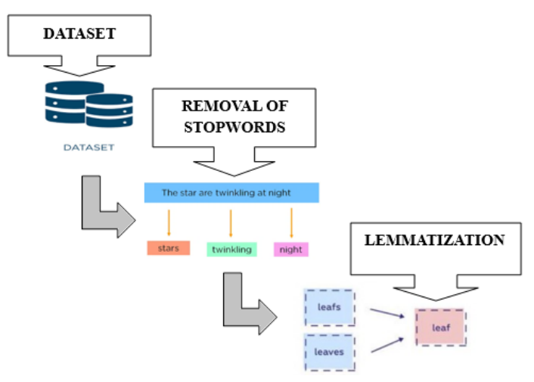
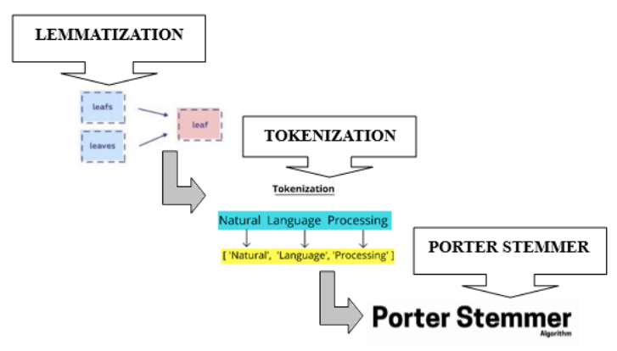
METHODOLOGY
Dataset Preprocessing

Slide 8
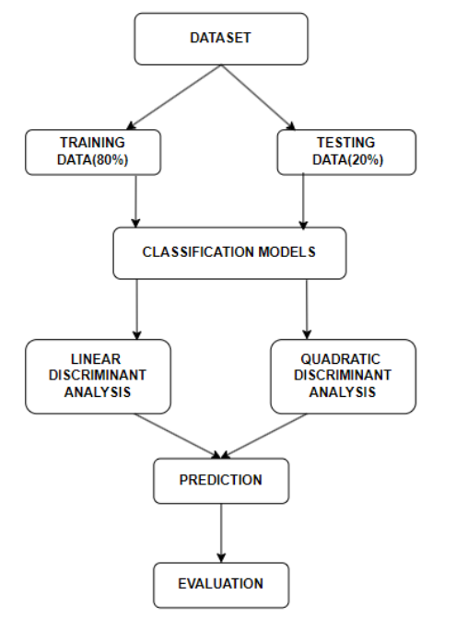
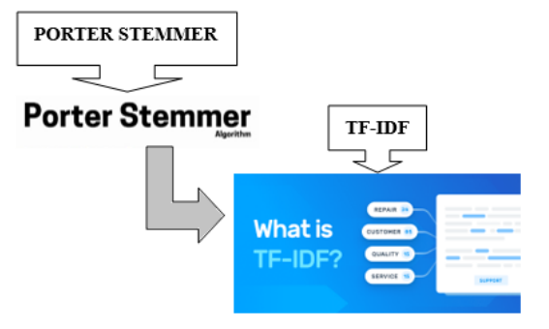
METHODOLOGY
Dataset Preprocessing
Process for Classification

Slide 9
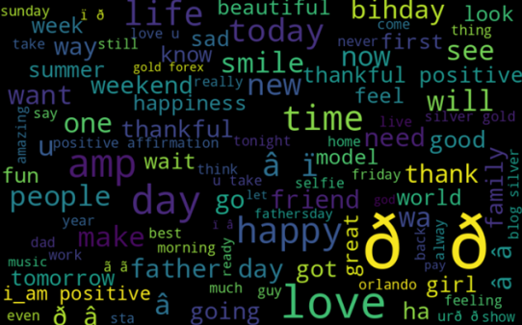
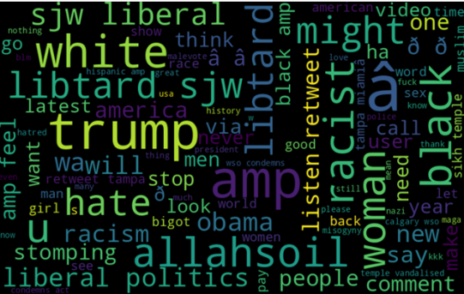
RESULTS AND DISCUSSIONS
World Cloud For Positive Hearing
World Cloud For Negative Hearing

Slide 10
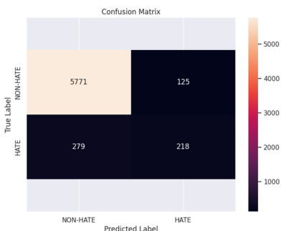
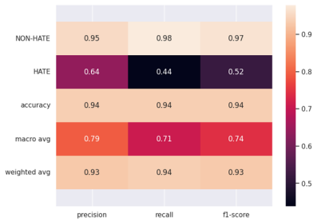
RESULTS AND DISCUSSIONS
Linear Discriminant Analysis:
Heatmap of LDA
Confusion Matrix of LDA

Slide 11
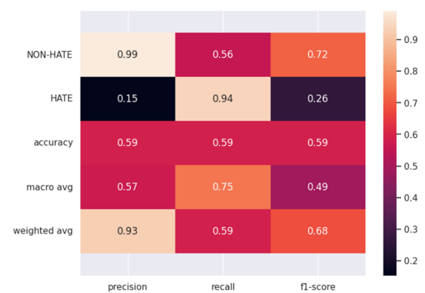
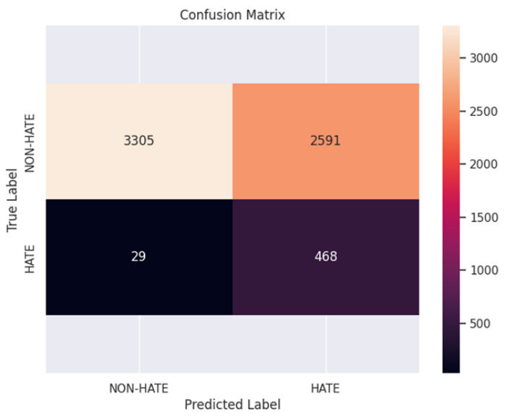
RESULTS AND DISCUSSIONS
Quadratic Discriminant Analysis:
Heatmap of QDA
Confusion Matrix of QDA

Slide 12
Superior Performance of Linear Discriminant Analysis: Highlights the superior accuracy of Linear Discriminant Analysis (LDA) over Quadratic Discriminant Analysis (QDA) in classifying tweets accurately. Reduced Misclassification with LDA: Emphasizes that LDA is more effective in correctly identifying non-hate tweets, thereby reducing the mislabeling of such tweets as hate speech. Metrics Comparison: LDA outperforms QDA in key performance metrics such as Precision, Recall, and F1-Score, indicating a more balanced and accurate classification ability. Towards a Respectful Digital World: The study underscores the importance of ongoing development in hate speech detection to improve online safety and contribute to a more respectful digital environment, adapting to the evolving nature of digital communication.
CONCLUSION

Slide 13
REFERENCES
A. Nayla, C. Setianingsih and B. Dirgantoro, ”Hate Speech Detection on Twitter Using BERT Algorithm,” 2023 International Conference on Computer Science, Information Technology and Engineeringt (ICCoSITE), Jakarta, Indonesia, 2023, pp. 644-649, doi: 10.1109/ICCoSITE57641.2023.10127831.
S. S. Syam, B. Irawan and C. Setianingsih, ”Hate Speech Detection on Twitter Using Long Short-Term Memory (LSTM) Method,” 2019 4th International Conference on Information Technology, Information Systems and Electrical Engineering (ICITISEE), Yogyakarta, Indonesia, 2019, pp. 305-310, doi: 10.1109/ICITISEE48480.2019.9003992.
A. Razdan and S. S, ”Hate Speech Detection using ML algorithms,” 2021 International Conference on Artificial Intelligence and Machine Vision (AIMV), Gandhinagar, India, 2021, pp. 1-6, doi: 10.1109/AIMV53313.2021.9670987.
P. Juszczak, D. M. J. Tax, S. Verzakov and R. P. W. Duin, ”Domain Based LDA and QDA,” 18th International Conference on Pattern Recognition (ICPR’06), Hong Kong, China, 2006, pp. 788-791, doi: 10.1109/ICPR.2006.461.
S. Shah, X. Yuan and Z. Tyler, ”An Analysis of COVID-19 related Twitter Data for Asian Hate Speech Using Machine Learning Algorithms,” 2022 1st International Conference on AI in Cybersecurity (ICAIC), Victoria, TX, USA, 2022, pp. 1-6, doi: 10.1109/ICAIC53980.2022.9896967.

Slide 14
Thank you Questions & Discussion

